Slide 1
LANGUAGE PASSPORT
Any person who wants to study or find a job abroad is supposed to meet certain requirements. One of them is usually a good command of a language.
There are some documents to make your skills and qualifications clearly and easily understood in Europe.

Slide 2
LANGUAGE PASSPORT
The EUROPEAN LANGUAGE PORTFOLIO (developed by the Council of Europe) was and launched in 2001. It is a document in which those who are learning or have learned a language - whether at school or outside school - can record and reflect on their language learning and cultural experiences.
One of the aims is to provide a record of the linguistic and cultural skills a person has acquired.

Slide 3
LANGUAGE PASSPORT
The EUROPEAN LANGUAGE PORTFOLIO (ELP) is divided into three parts, and one of them is the LANGUAGE PASSPORT. It is a self-assessment tool for language skills and qualifications based on European Language Levels (CEFR).

Slide 4
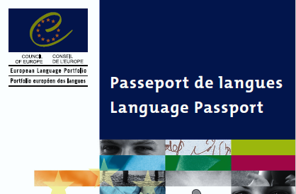
LANGUAGE PASSPORT

Slide 5
LANGUAGE PASSPORT
The EUROPEAN LANGUAGE PORTFOLIO (ELP) is divided into three parts, and one of them is the LANGUAGE PASSPORT. It is a self-assessment tool for language skills and qualifications based on European Language Levels (CEFR).

Slide 6
LANGUAGE PASSPORT
It uses the self-assessment grid consisting of six levels (from Basic to Proficient User) and looks at the language proficiency from the point of view of the skills in understanding, speaking and writing.

Slide 7
LANGUAGE PASSPORT
As the bodies developing the Portfolio and other documents are working, you can find different templates and samples of Language passports. But their idea is as follows:
reflect on one’s language learning experience (regardless whether gained inside or outside of formal education)
record it using some standards linked to the Common European Framework of Reference for Languages (CEFR)

